Slide 1
FOREIGN DIRECT INVESTMENT

Slide 2
CONTENTS
Introduction
Yearly FDI Analysis
Sector wise Contribution (2016-17)
Growth Rate Analysis
Sector Relation Analysis
Inter Sector Analysis
Summary

Slide 3
INTRODUCTION
This includes analysis for investment on different companies or sectors.
Data includes investment inflow for different sectors for financial year 2000-01 to 2016-17.
This can also find relation between different sectors for investment.

Slide 4
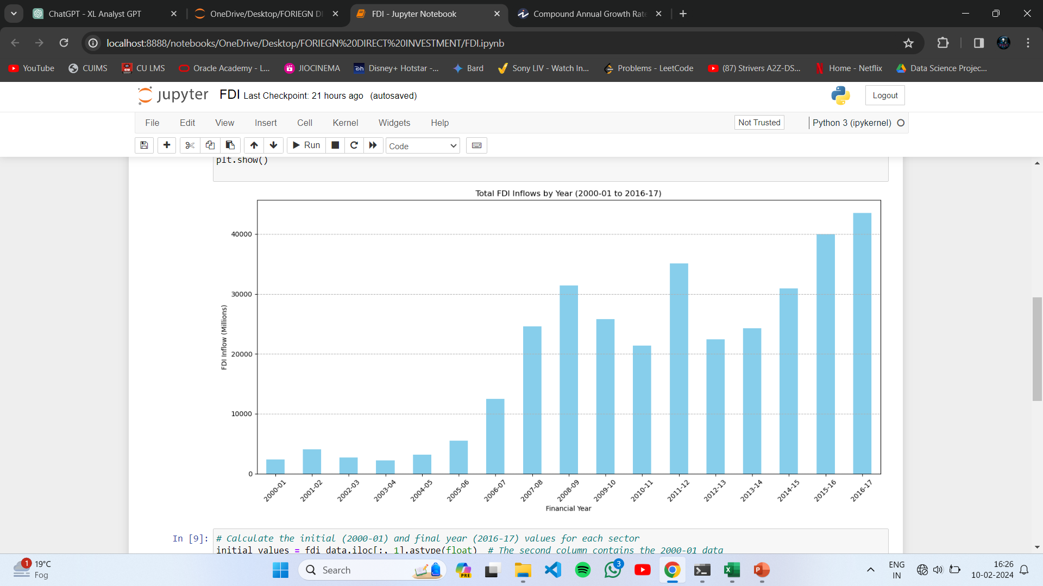
YEARLY FDI ANALYSIS
Yearly Analysis shows a continuous growth in past 17 years.
2011-12 showed a great growth and but just after a great loss too.

Slide 5
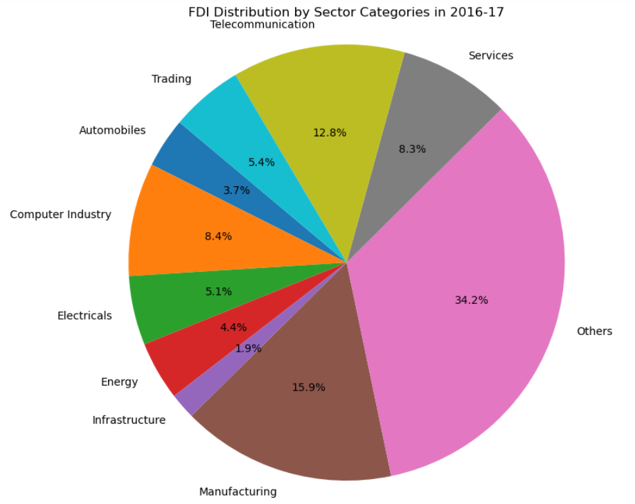
SECTOR WISE CONTRIBUTION (2016-17)
Primary contributor is Manufacturing Industry which includes Chemicals, Textiles, Metallurgical, Cement, Rubber, Sugar, Paper, etc.
Other major contributors are Telecommunication, Computer, Trading and Electricals.
Service sector include Education, Medical, Consultancy, Tourism, Finance and Broadcasting.

Slide 6
GROWTH RATE ANALYSIS
SECTORS | CAGR (%)
RUBBER GOODS | 58.909750
SEA TRANSPORT | 40.002449
TEXTILES (INCLUDING DYED,PRINTED) | 39.878915
TRADING | 36.709888
SERVICES SECTOR (Fin., Banking, Insurance, Non-Fi... | 32.634252
MEDICAL AND SURGICAL APPLIANCES | 30.175185
HOTEL & TOURISM | 28.326591
METALLURGICAL INDUSTRIES | 27.653948
CONSULTANCY SERVICES | 27.410426
INDUSTRIAL MACHINERY | 27.243601
CAGR = Compounded Annual Growth Rate
Best growth is seen in Rubber Goods Sectors followed by Sea Transport and Textiles.

Slide 7
SECTORS RELATION ANALYSIS
Technology-Related Sectors: Sectors like "Computer Software & Hardware" and "Telecommunications" exhibit a positive correlation.
Manufacturing and Infrastructure: Sectors such as "Automobile Industry," "Metallurgical Industries," and "Construction Development" show positive correlations with each other.

Slide 8
INTER SECTOR ANALYSIS

Slide 9
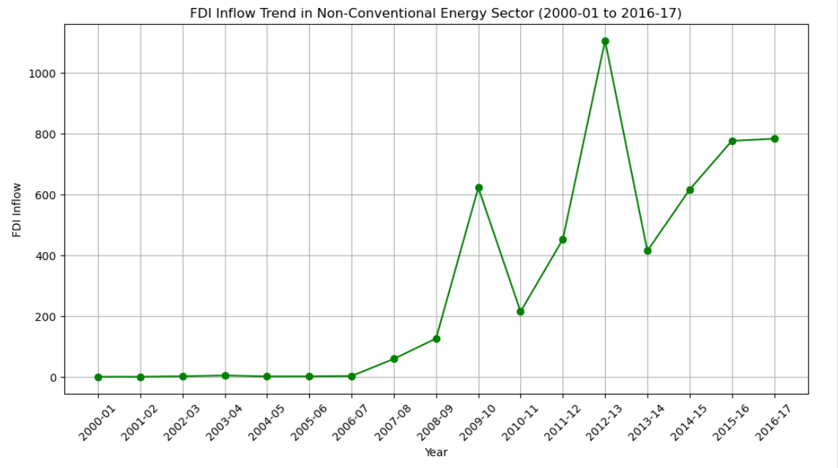
NON CONVERSATIONAL ENERGY
Category started from 2007-08.
Continuously growing Industry.
Showed a peak in 2012-13.
Increasing after the loss in 2013-14.

Slide 10
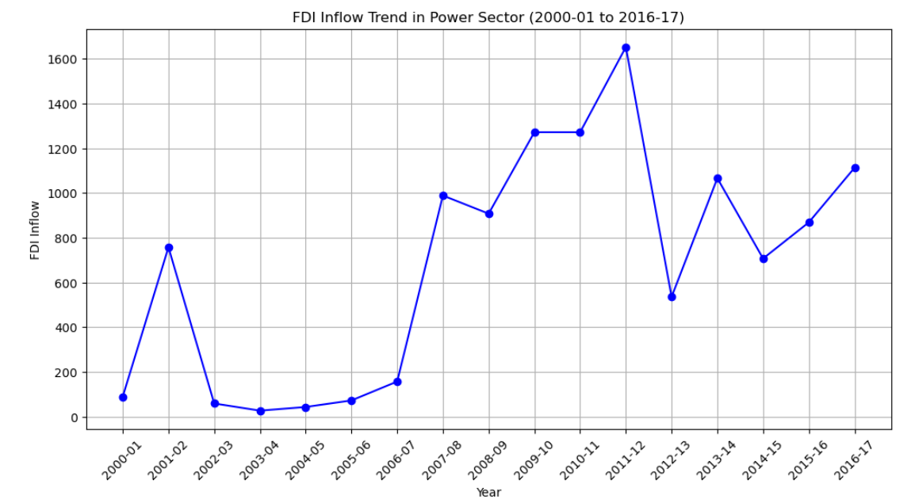
NON CONVERSATIONAL ENERGY
Most fluctuating category.
Lowest phase between 2002-2007 after a good start in 2001.
A great growth in 2007-08.
A Huge loss in 2012-13.
Increasing after the loss in 2014-15.

Slide 11
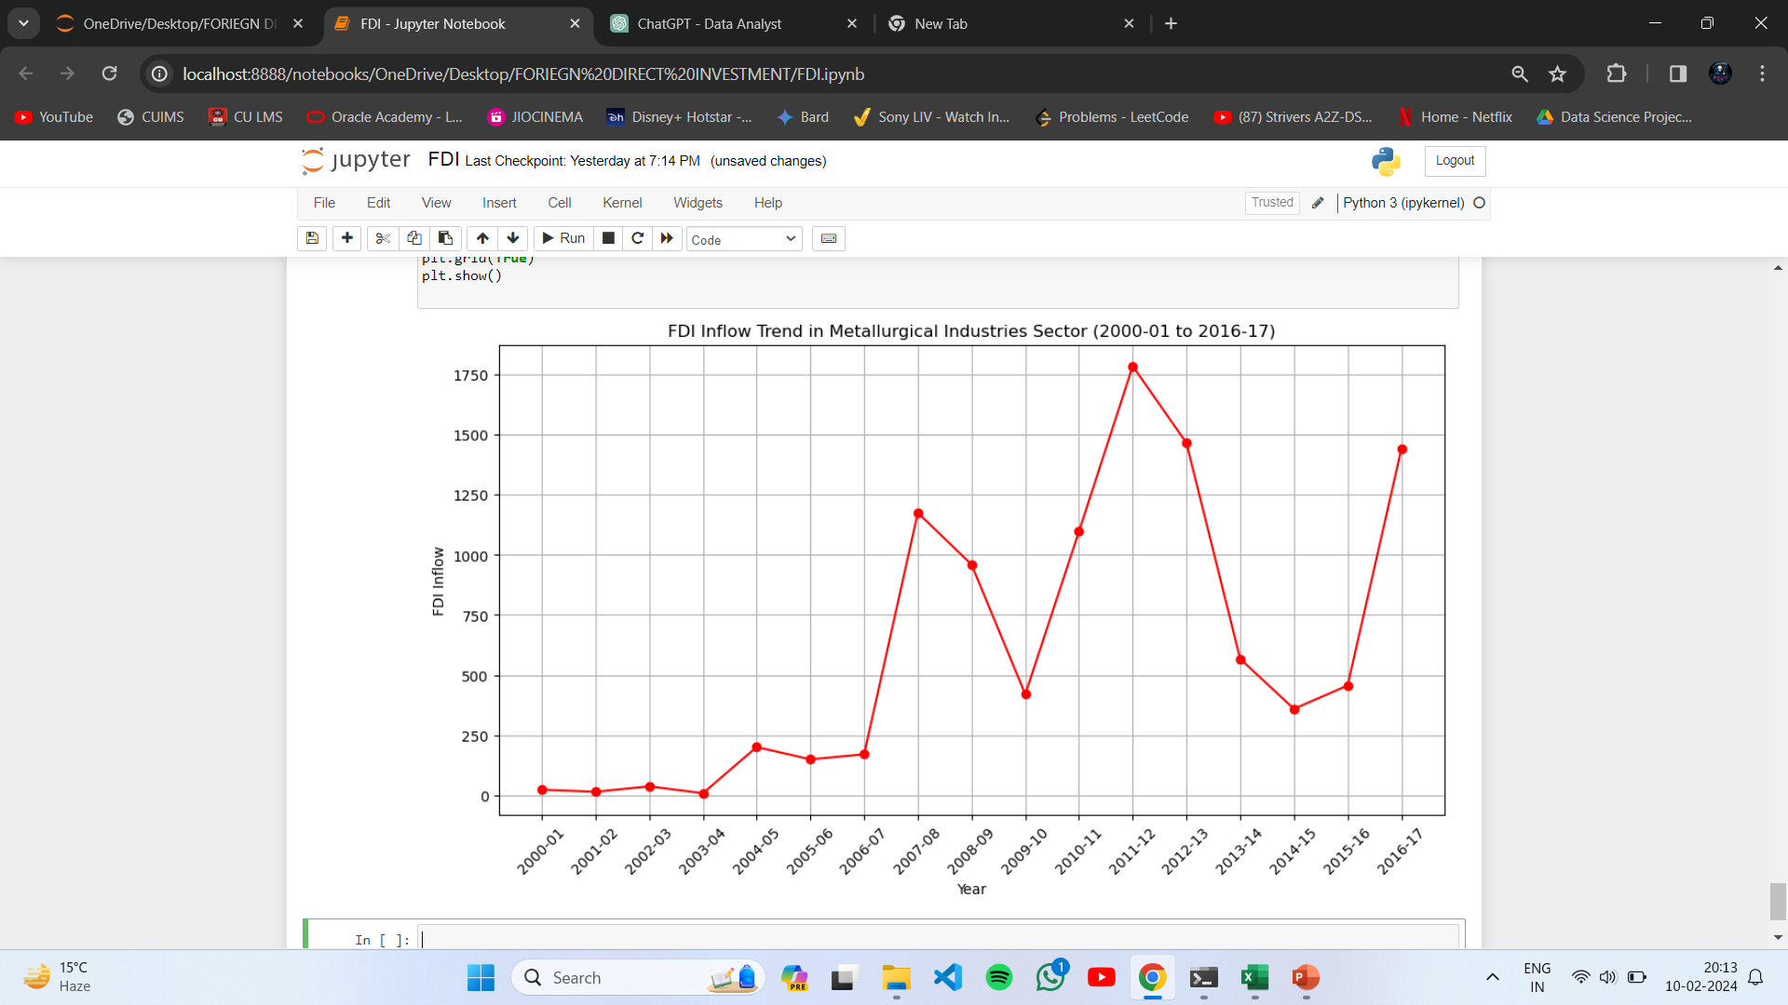
NON CONVERSATIONAL ENERGY
A slow start till 2006-07.
Good pickup in 2007-08.
Fluctuating after 3-4 years.
Continuously loss after peak in 2011-12.
Started rising again after 2014-15.

Slide 12
SUMMARY
Some industries like rubber, sea transport and textiles have showed a great growth.
Others have experienced a fluctuating growth.
Overall the average FDI inflow is increasing every year.

Slide 13
THANK YOU
Name:- Aayush Khanna
Phone:- +91 7351830828
Email:- aayushkhanna0201@gmail.com
LinkedIn:- https://www.linkedin.com/in/aayush-khanna-0192a6219/
GitHub:- https://github.com/aayush674

